Slide 1
Hepatite autoimune induzida por drogas
John Hart, MD
Universidade de Chicago, EUA

Slide 2
Declaração de Conflito de Interesse
Dr Hart não ter conflito de interesse a declarar
Exigência da RDC Nº 96/08 da ANVISA

Slide 3

Autoimmune Hepatitis:
Clinical & Laboratory Features
Female gender; other autoimmune conditions
Serum hypergammaglobulinemia [5%*]
Serum autoantibodies (low titer in children):
  antinuclear antibody (ANA) [15-24%*]
  anti-smooth muscle antibody (ASMA) [up to 42%*]
  anti-liver kidney microsomal (LKM-1) antibody [1%*]
* [Prevalence in normal populations] (J Hepatol 2019; 70:1222-61.)

Slide 4
Autoimmune Hepatitis:
Histologic Features
Brisk interface and lobular necroinflammatory activity at presentation in most cases
Plasma cells are prominent in most cases (85%)
Centrilobular necroinflammatory activity can occur
Grading does not influence treatment!

Slide 5
International Autoimmune Group Revised Criteria for Diagnosis of AIH
Gender: Score
  Male 0
  Female +2
Serum biochemistry (AP:AST/ALT)
  > 3.0 -2
  1.5-3.0 0
  <1.5 +2
Total serum globulin or IgG
  >2.0 +3
  1.5-2.0 +2
  1.0-1.5 +1
  <1.0 0
Autoantibodies Score
  ANA, SMA, or LKM-1
    >1:80 +3
    1:80 +2
    1:40 +1
    <1:40 0
  AMA
    Positive -4
    Negative 0
Viral Hepatitis Markers
  Negative +3
  Positive -3
Alverez F et al. J Hepatology 1999; 31:929-38.

Slide 6
International Autoimmune Group Revised Criteria for Diagnosis of AIH
Other etiological factors Score
  History of medication use
    Yes -4
    No +1
  EtOH
    <25 g/day +2
    >60 g/day -2
  Genetics: HLA DR3 or DR4 +1
  Other autoimmune disease +2
  Response to steroid therapy
    Complete +2
    Relapse upon taper +3
Liver histology Score
  Interface hepatitis +3
  Predominant lympho-
  plasmacytic infiltrate +1
  Rosetting of liver cells +1
  None of the above -5
  Biliary changes -3
  Other changes -3
Sero+ for atypical autoantibodies +2
Scores: Pre-tx Post-tx
Definite AIH: >15 pts >17 pts
Probable AIH: 10-15 pts 12-17 pts

Slide 7
Clinical history
+2
+2
37 year old female with SLE presents with RUQ pain, nausea, fatigue
Developed jaundice and went to the ER
TB = 21.1, AST = 2879, ALT = 1939, alk phos = 139
No medications; no significant alcohol
ANA = 1:2560; + anti-SMA; gamma-globulin = 3.34
HAV, HBV and HCV negative
Admitted and liver biopsy performed
+2
+1
+1
+3
+3
+?
Scores: Pre-tx Post-tx
Definite AIH: >15 pts >17 pts
Probable AIH: 10-15 pts 12-17 pts
Notes:
13 points without biopsy findings – already probable AIH

Slide 8
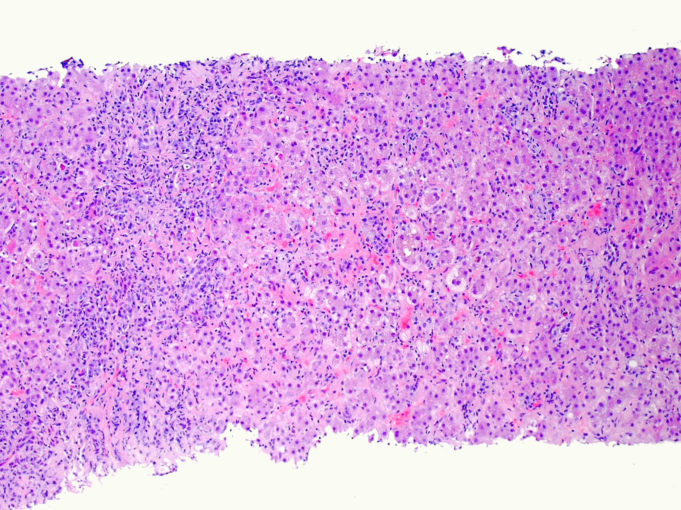
interface hepatitis with lymphoplasmacytic infiltrates

Slide 9
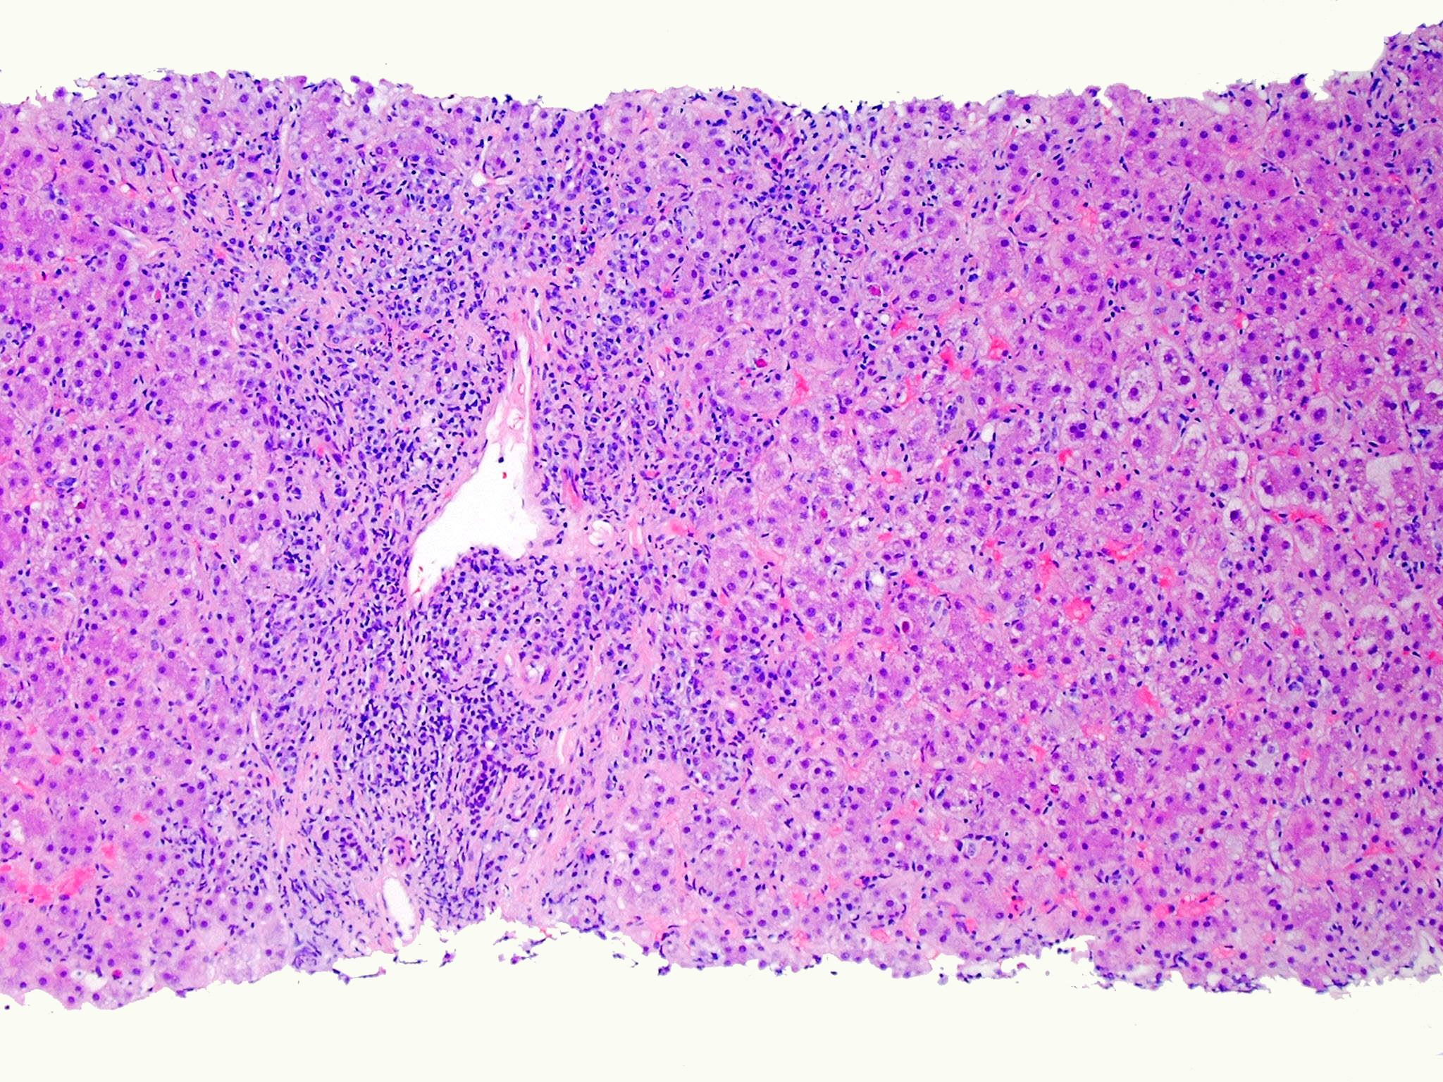
interface activity = +3; plasma cells +1

Slide 10
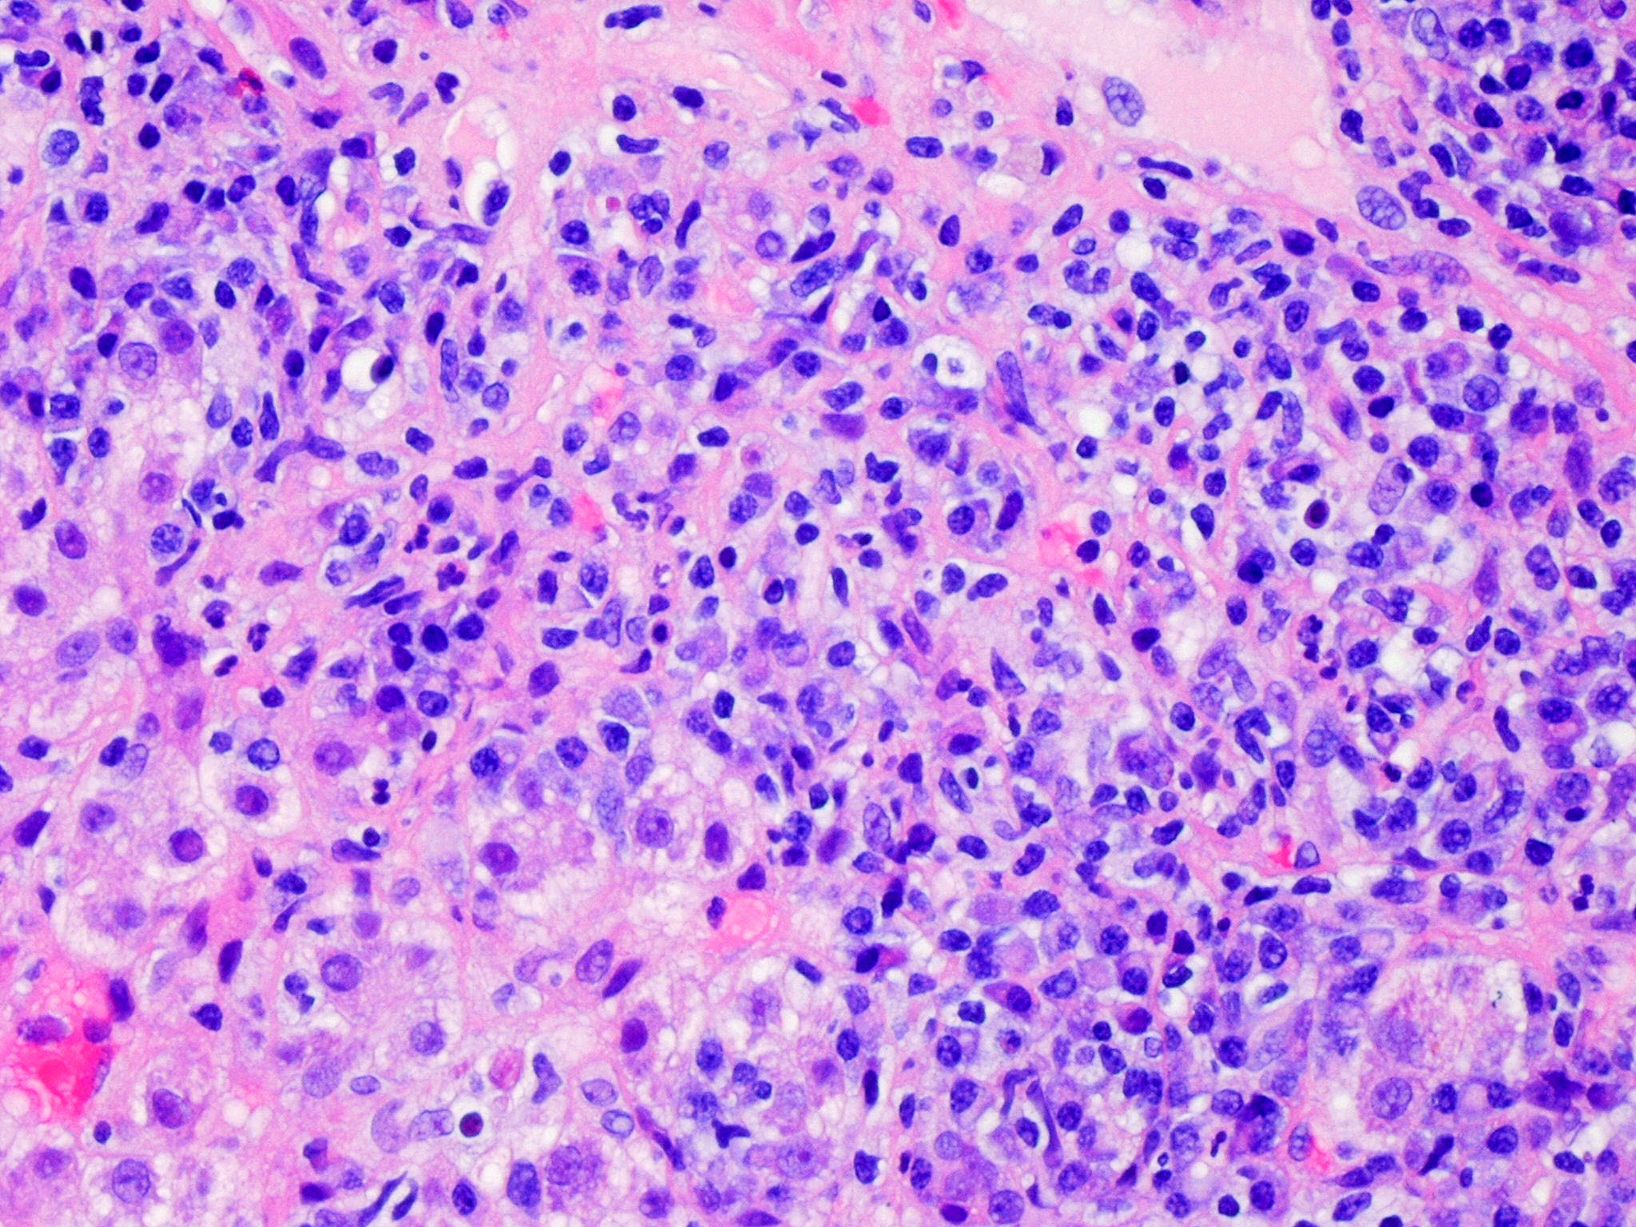

Slide 11
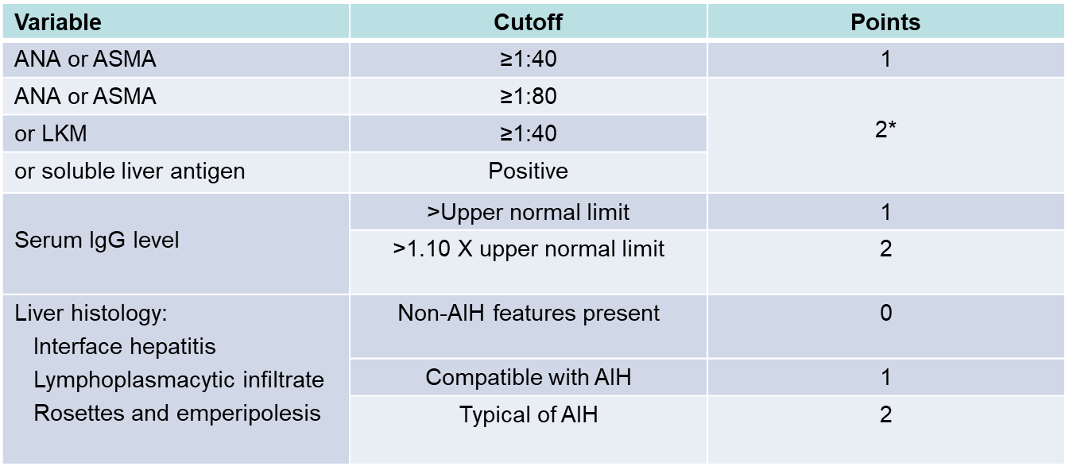
Simplified AIH Diagnostic Criteria
No mention of possible drug trigger!
______________________________
≥6 points: probable AIH
≥7 points: definite AIH (specificity of 95%)
*Addition of points achieved for all autoantibodies (maximum, 2 points)
Hennes et al, Hepatology 2008;48:169-176
Notes:
DOESN’T INCLUDE MEDICATION HISTORY!!!

Slide 12
Clinical History
60 y.o. F with rheumatoid arthritis presents with severe dyspnea & jaundice
Chest CT scan revealed bilateral interstitial lung disease and lung biopsy demonstrated NSIP
TB = 2.5, AST = 138, ALT = 112, alk phos = 120
HAV, HBC and HCV serologies are negative
ANA = 1:640 and anti-SMA = 1:160
History of chronic urinary tract infections and has been on maintenance nitrofurantoin for the past 4 years

Slide 13
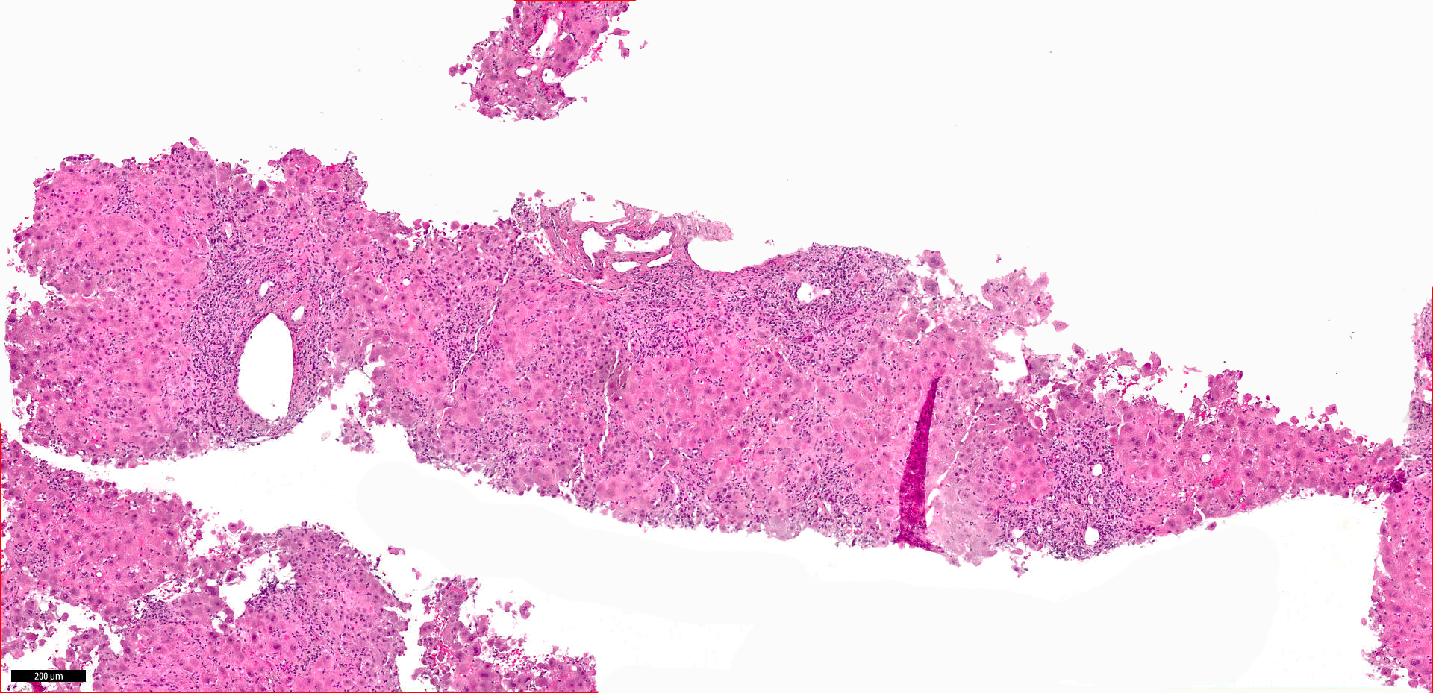
Case 3 DILI AIH Case 109 nitrofuritoin

Slide 14
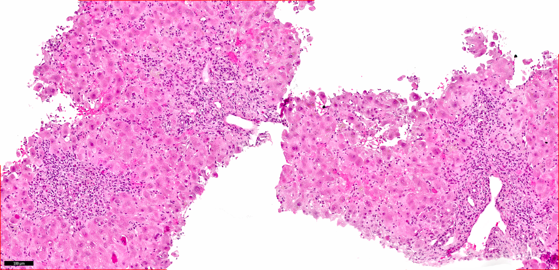
Case 3 DILI AIH Case 109 nitrofuritoin

Slide 15
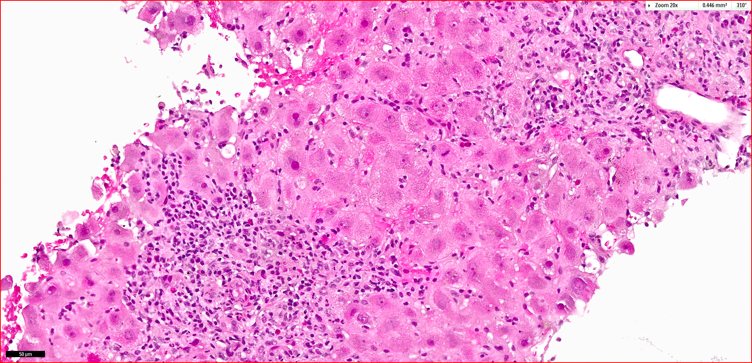
Case 3 DILI AIH Case 109 nitrofuritoin

Slide 16
Drug Triggered AIH (immune mediated drug-induced liver injury, IM-DILI)
Almost always a female patient
Onset many months after medication is started
+ ANA and/or anti-SMA; high serum immunoglobulin
Peripheral blood eosinophilia and hypersensitivity symptoms in a minority
Typical histology for AIH
Common meds: isoniazid, propylthiouracil, nitrofurantoin, minocycline, fibrates, statins, hydralazine and methyldopa
Medication must be stopped
Steroid treatment, but can be tapered and stopped in many
Björnsson ES et al. Drug-induced autoimmune hepatitis: response to corticosteroids and lack of
relapse after cessation of steroids. Clin Gastroenterol Hepatol 2017;15:1635–36.

Slide 17
Clinical History

Slide 18
Clinical History
19 year old female with Hashimoto’s thyroiditis presents with 10 day history of jaundice and mild right upper quadrant pain
TB = 4.7, AST = 1088, ALT = 890, alk phos = 110
PT = 12.3, PTT = 33.5, INR = 0.9
ANA = 1:2560, anti-SMA negative
HAV, HBV, HCV, HEV negative
EBV, CMV, HSV, Varicella negative
Urine toxicology screen negative
Ceruloplasmin and 24 hour urine copper – no evidence of Wilson disease

Slide 19
Clinical Course
Treated with steroids for presumptive AIH
AST and ALT improve somewhat but don’t normalize
Liver biopsy now performed

Slide 20
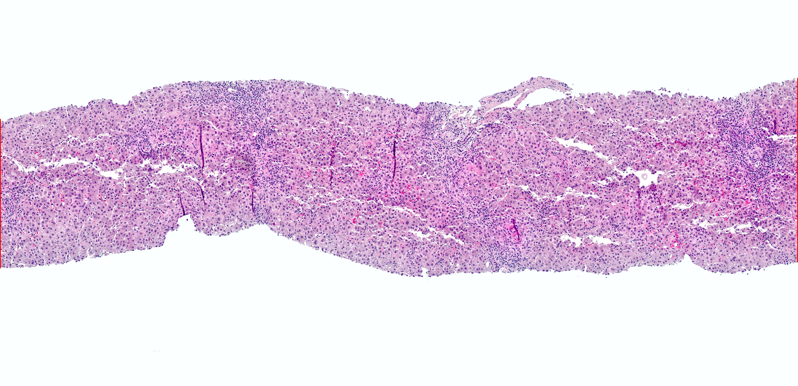

Slide 21
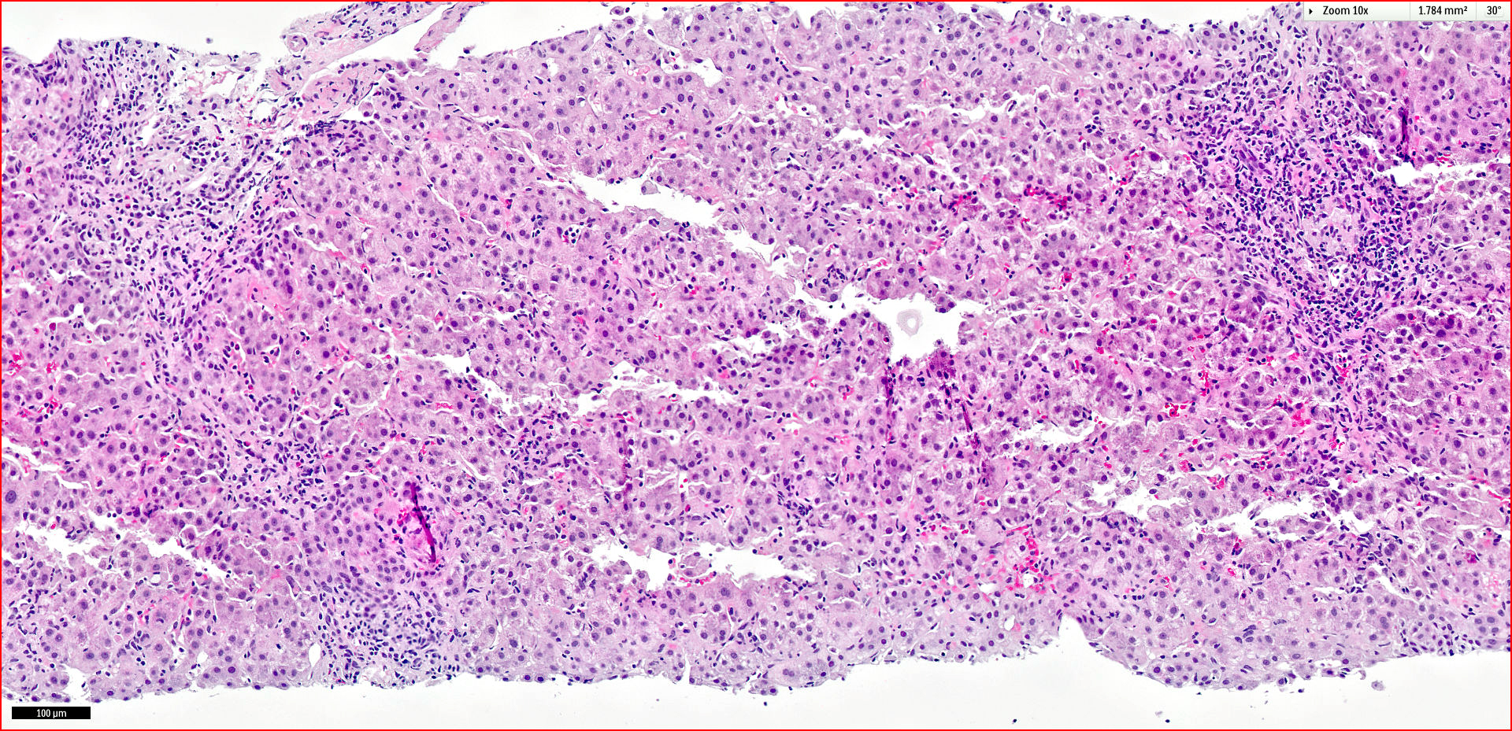

Slide 22
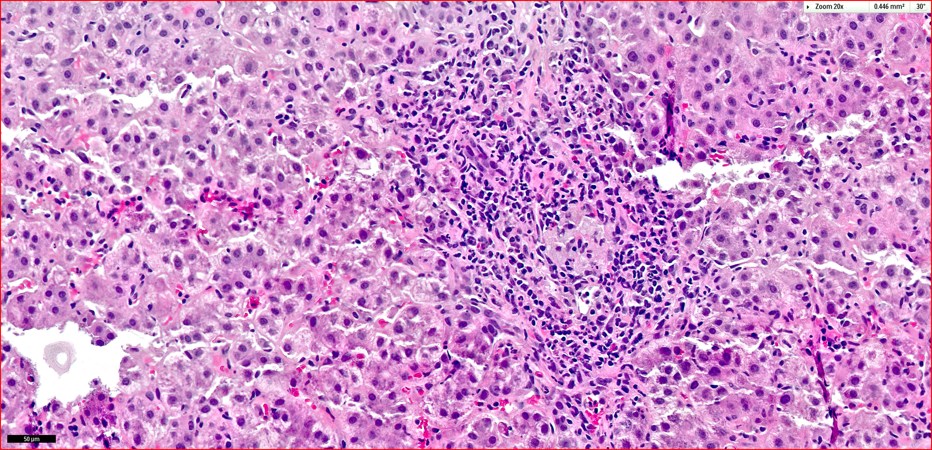

Slide 23
Additional Clinical Information
Started minocycline one year ago for acne
Minocycline now stopped
Started on Budesonide and azathioprine
After 3 weeks: TB = 2.7, AST = 100, ALT = 160
Budesonide tapered off
Labs normal at 6 months on 125 mg azathioprine
Azathioprine stopped --- no recurrence

Slide 27
Drug induced AIH versus de novo AIH
Suggestive of DI-AIH
Prolonged use of a typical medication
Incomplete response to steroid treatment*
Suggestive of de novo AIH
Very brisk interface activity
Significant fibrosis at presentation
Not Helpful in the Distinction
Significant component of eosinophils
Centrilobular necroinflammatory activity
* Also consider Wilson disease in a patient < 50 years old

Slide 28
obrigado(A)!

